Slide 1
Rotating objects
Transformations

Slide 2
how to use Oak lessons

Slide 3
I can rotate objects using information about centre, size and direction of rotation.

Slide 4
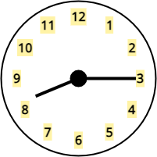
Clockwise is the direction that the hands of an analogue clock travel.
Anti-clockwise is the opposite direction to which the hands of an analogue clock travel.
The centre of rotation is the fixed point about which an object is rotated. It fixes the location of the image after it is rotated.
Degrees are the most common unit of measurement for angle. One whole turn is equal to 360 degrees, written 360°.

Slide 5

Rotating objects
Rotating with tracing paper and centre on a vertex
Rotating objects with centre outside the object
Rotating objects with centre in or on the object

Slide 6
Rotating with tracing paper and centre on a vertex
For this lesson, it is important to have tracing paper, a pencil, and a ruler.
The tracing paper will be used to trace over:
the centre of rotation
the object

Slide 7
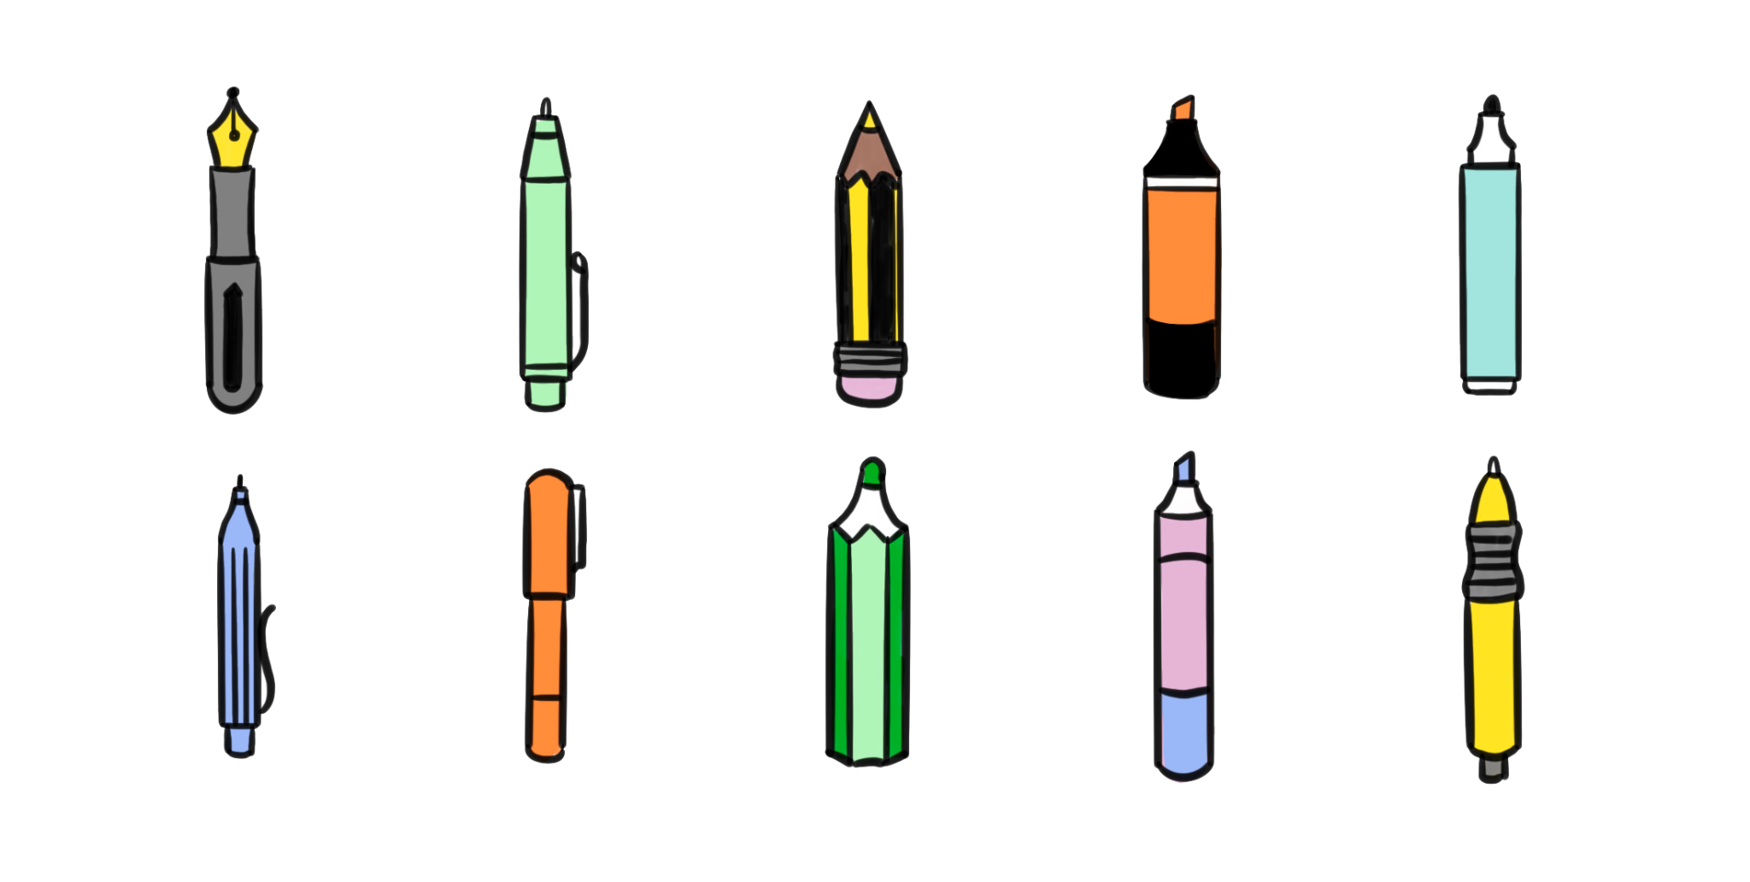
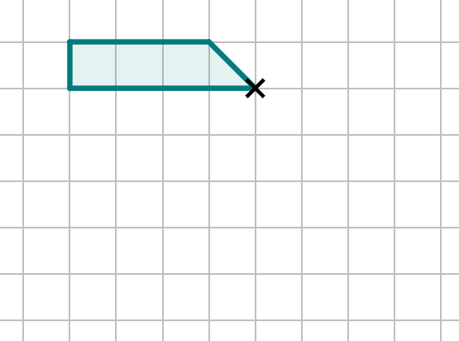
Rotating with tracing paper and centre on a vertex
Task
Rotate this shape by 90° anti-clockwise at the centre of rotation marked ×.
Instructions
Place tracing paper over the object.
×
×
×
×
×
×
×
Using a pencil, sketch over the object and put a × at the location of the centre of rotation.
Push your pencil into the centre of rotation to keep the tracing paper in place.
Rotate the tracing paper 90° anti-clockwise.

Slide 8
Rotating with tracing paper and centre on a vertex
Task
Rotate this shape by 90° anti-clockwise at the centre of rotation marked ×.
Instructions
Keep the tracing paper as still as possible.
×
Firmly push the pencil into each of the vertices of the image on the tracing paper.
This will imprint the vertex of the image onto the paper.

Slide 9

Rotating with tracing paper and centre on a vertex
Task
Rotate this shape by 90° anti-clockwise at the centre of rotation marked ×.
Instructions
When all vertices are visible on the paper, remove the tracing paper.
×
90°
Join up all the vertices on the paper to complete the shape.
We can see that the image is a 90° anti-clockwise rotation of the object.

Slide 10
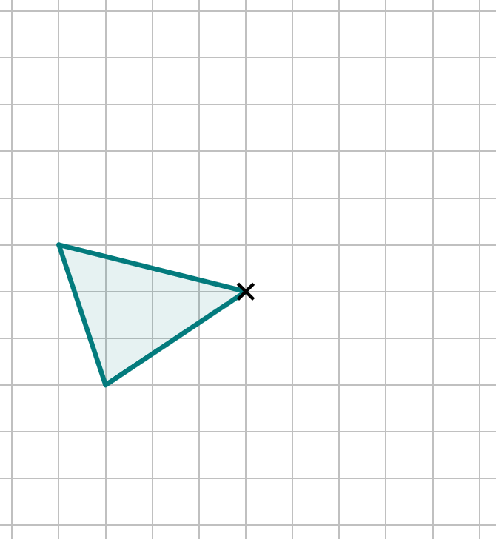
Rotating with tracing paper and centre on a vertex
Demonstration
Use a: pencil, ruler, and tracing paper.
Rotate this shape by 90° clockwise at the centre of rotation marked ×.
Rotating a shape with none of the sides resting on the gridlines can be tricky!

Slide 11
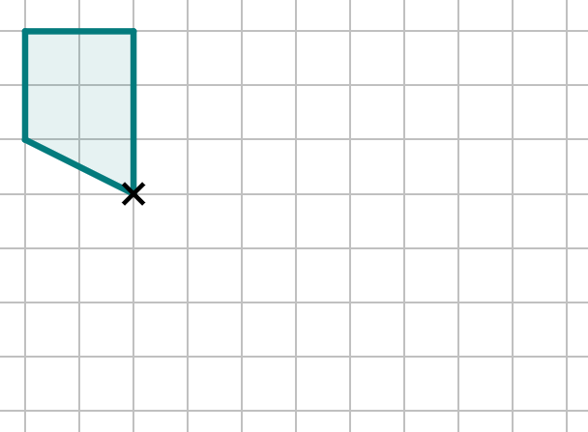
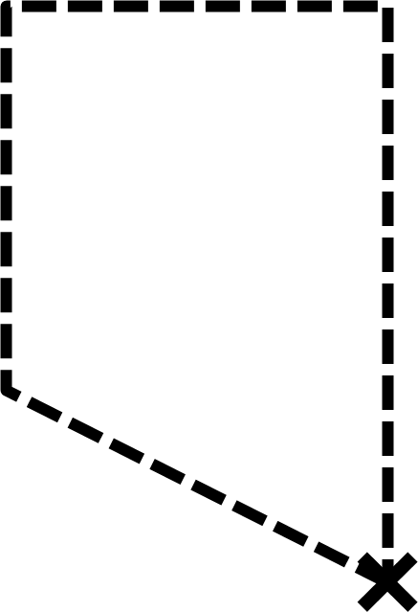
Rotating with tracing paper and centre on a vertex
After placing the tracing paper over the paper, what two things must I draw onto the tracing paper?
The object
The centre of rotation

Slide 12
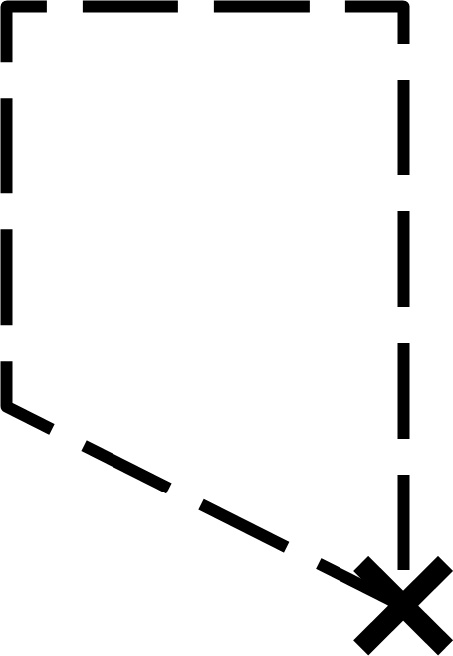


Rotating with tracing paper and centre on a vertex
The object needs to be rotated 90° around the centre of rotation marked.
Which of these is the correct placement of the tracing paper after the rotation has happened?
a
b
c

Slide 13
Rotating with tracing paper and centre on a vertex
After which step do you push your pencil firmly onto each vertex of the shape on the tracing paper to leave an imprint on the paper?
a
After placing the tracing paper over the paper
b
After sketching the object onto the tracing paper
c
After rotating the tracing paper

Slide 14
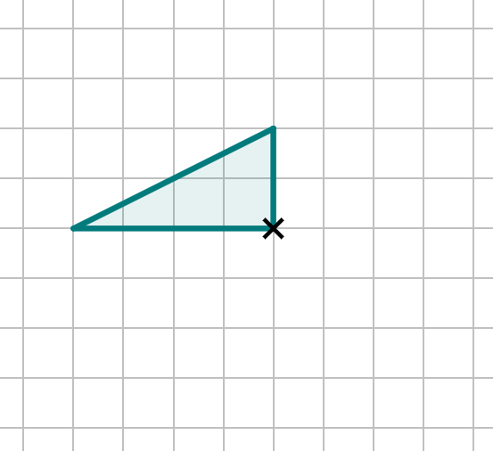
Rotating with tracing paper and centre on a vertex
Task
Rotate this shape clockwise by 90° around the centre of rotation given. Repeat this rotation two more times, but each time start from the image you have just drawn, and treat that as the new object.
Instructions
Place the tracing paper over the object and sketch the object and centre of rotation onto the tracing paper.
Rotate the tracing paper 90° clockwise, then push down on the paper at each vertex.
Draw the rotated image onto the paper.

Slide 15
Rotating with tracing paper and centre on a vertex
Task
Rotate this shape clockwise by 90° around the centre of rotation given. Repeat this rotation two more times, but each time start from the image you have just drawn, and treat that as the new object.
Instructions
Place the tracing paper back on, lining it up with your image.
Repeat the rotation step again, rotating another 90° and drawing a second image.
And repeat once more to complete the third rotation.

Slide 16
Rotating with tracing paper and centre on a vertex
What does the shape created look like?
Are each of the images congruent or different?
A windmill or pinwheel shape
Every image is congruent to each other and to the original object.
This is because we are tracing and duplicating the object exactly, just with a different orientation.

Slide 17
Rotating with tracing paper and centre on a vertex
What would happen if we did a fourth rotation?
The original object would have rotated one full turn (360°) to get its image.
The fourth image would have both the same orientation and exact position as the object.
All images will have a different orientation to its object, unless a full turn of 360° occurs.

Slide 18
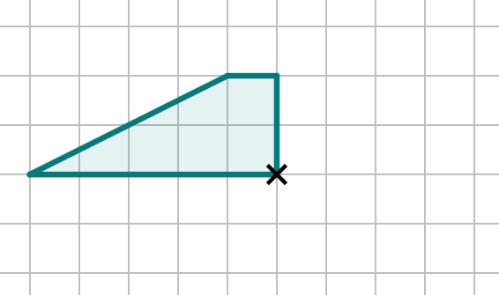
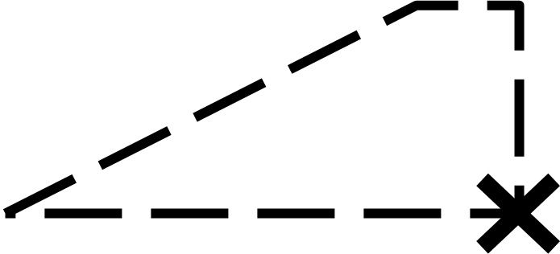
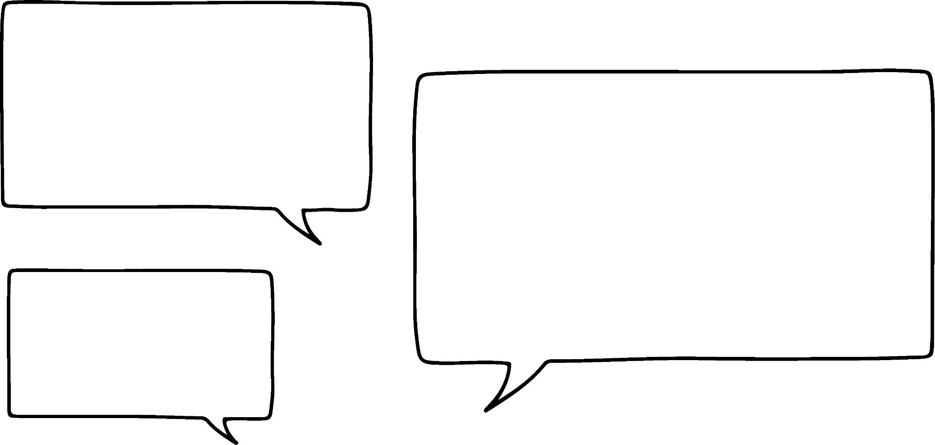
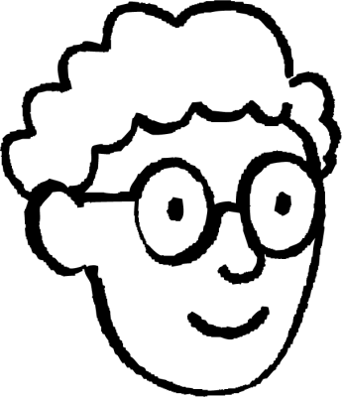
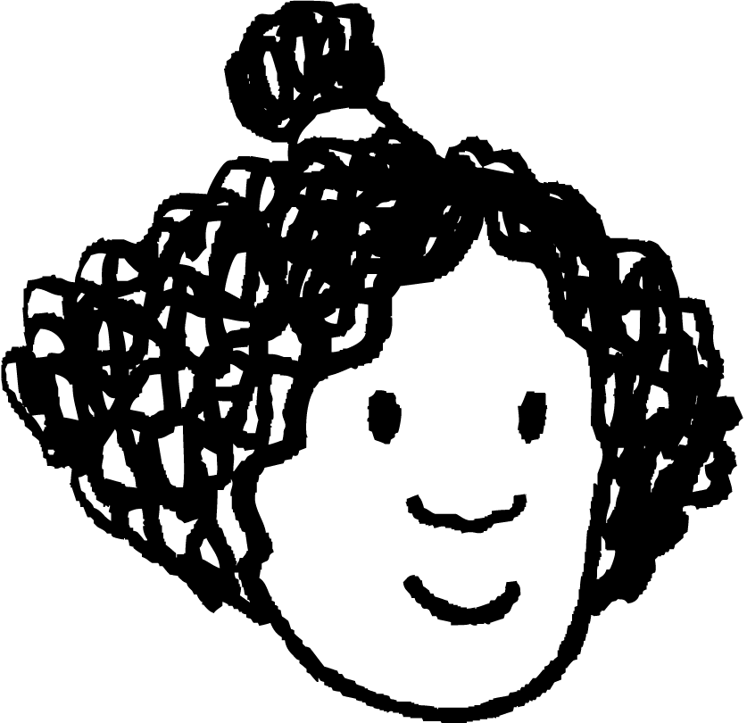
Rotating with tracing paper and centre on a vertex
Whose statement is correct? Can you explain why?
The tracing paper has not been rotated yet.
Alex
Yes it has!
Alex’s
Either one of them could be correct
a
c
Izzy’s
Neither of them are correct
b
d
Izzy

Slide 19
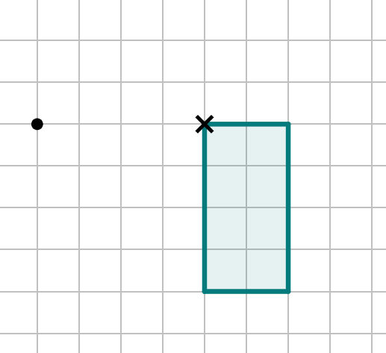
Rotating with tracing paper and centre on a vertex
1) Rotate the object by 90° clockwise about the centre of rotation that is labelled onto the vertex of the shape.
One of the vertices of your image should overlap with the on the grid.

Slide 20
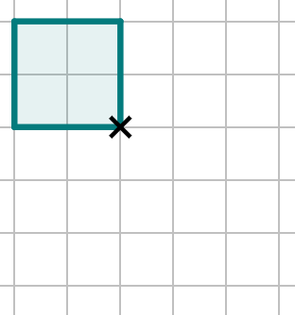
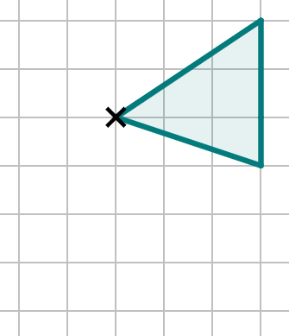
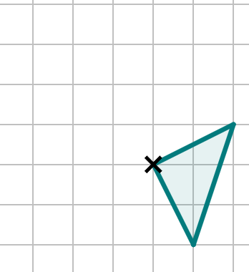
Rotating with tracing paper and centre on a vertex
2) Rotate the following objects about the centre of rotation that is labelled with a cross.
rotate 180°
rotate 90°
clockwise
rotate 90°
anti-clockwise

Slide 21
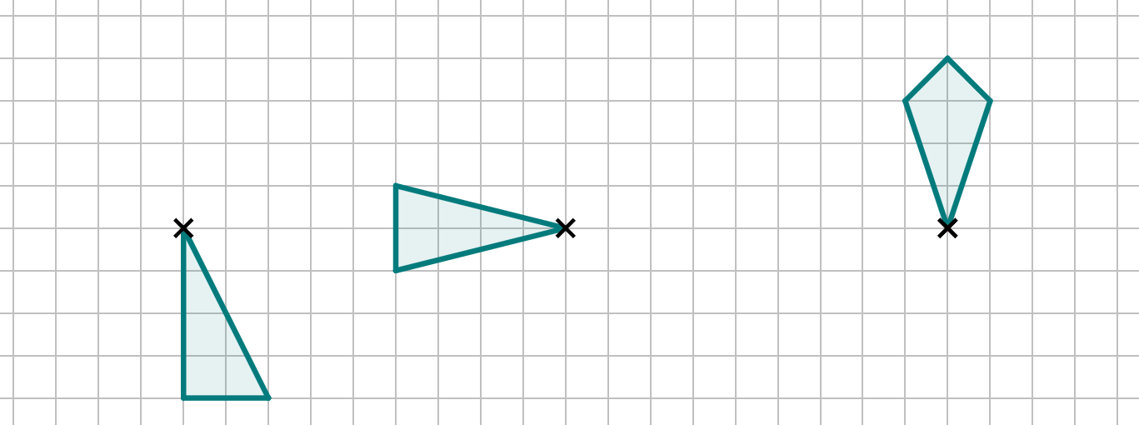
Rotating with tracing paper and centre on a vertex
3) Rotate each shape clockwise by 90° around the centre of rotation given. Repeat this rotation two more times, but each time start from the image you have just drawn, and treat that as the new object.
The result of each three rotations should look like a pinwheel or windmill.

Slide 22
Rotating with tracing paper and centre on a vertex
1) Rotate the object by 90° clockwise about the centre of rotation that is labelled onto the vertex of the shape.
One of the vertices of your image should overlap with the on the grid.

Slide 23
Rotating with tracing paper and centre on a vertex
2) Rotate the following objects about the centre of rotation that is labelled with a cross.
rotate 180°
rotate 90°
clockwise
rotate 90°
anti-clockwise

Slide 24
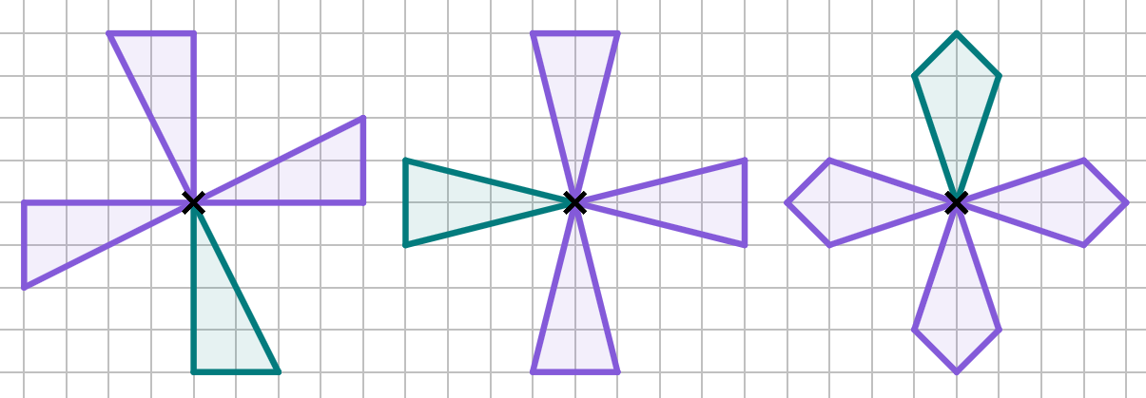
Rotating with tracing paper and centre on a vertex
3) Rotate each shape clockwise by 90° around the centre of rotation given. Repeat this rotation two more times, but each time start from the image you have just drawn, and treat that as the new object.
The result of each three rotations should look like a pinwheel or windmill.

Slide 25
Rotating objects
Rotating with tracing paper and centre on a vertex
Rotating objects with centre outside the object
Rotating objects with centre in or on the object

Slide 26
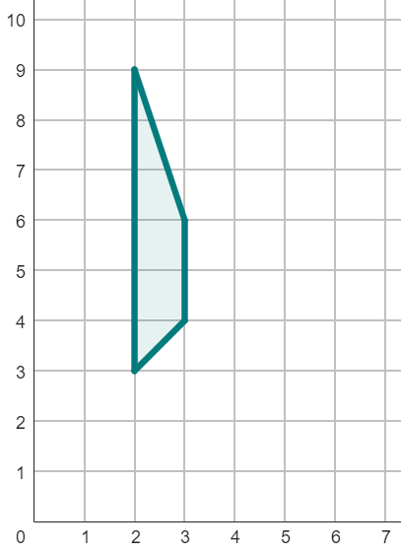
Rotating objects with centre outside the object
The centre of rotation may not be a vertex of your object.
Sometimes, it will be a point outside the object.
The centre of rotation can be labelled on a diagram or described, often as a coordinate for you to label yourself.
For example: rotate this object by 90° anti-clockwise around the centre of rotation of (5, 4).

Slide 27
Rotating objects with centre outside the object
Rotate this object by 90° anti-clockwise around the centre of rotation of (5, 4).
Instructions
Plot the coordinate of the centre of rotation first.
Trace the shape and centre of rotation on the tracing paper and rotate.

Slide 28
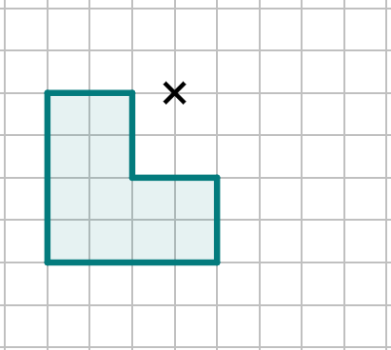
Rotating objects with centre outside the object
Even with the centre of rotation outside the object, your image may sometimes still overlap the object.
Rotate this object by 90° anti-clockwise around the centre of rotation given.
Unit square that overlaps image and object.

Slide 29
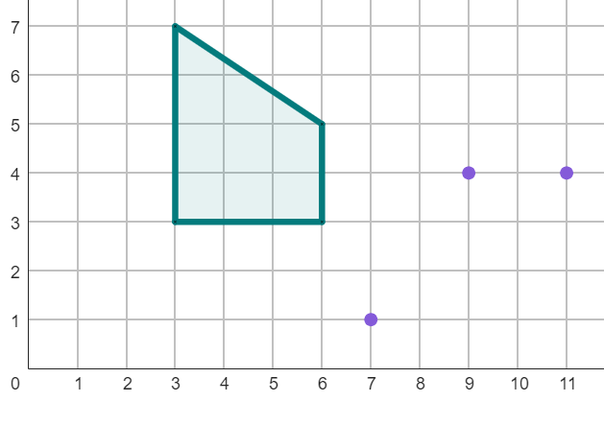
Rotating objects with centre outside the object
The object has been rotated by 90° anti-clockwise around the point (8, 6).
What is the coordinate of the missing vertex of the image?
object
(11, 1)

Slide 30
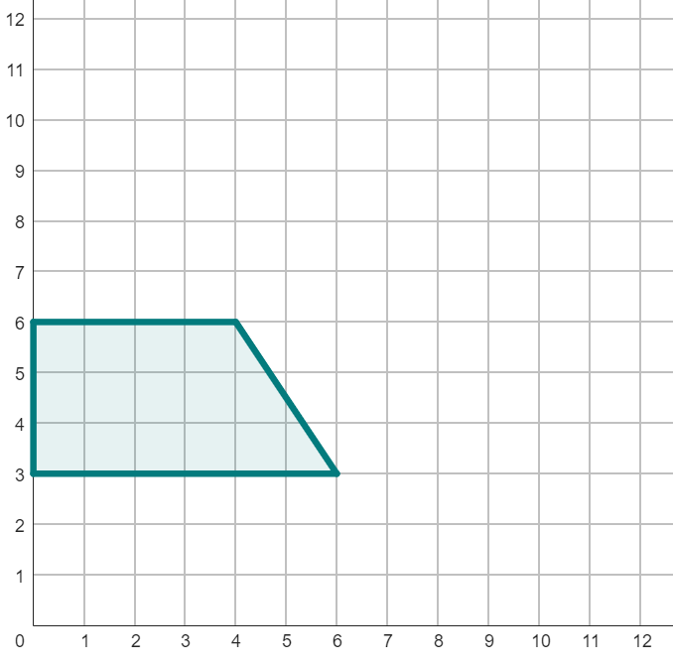
Rotating objects with centre outside the object
1) Rotate object A by 90° clockwise around the point (7, 5).
2) Rotate object A by 90° clockwise around the point (6, 0).
object A

Slide 31
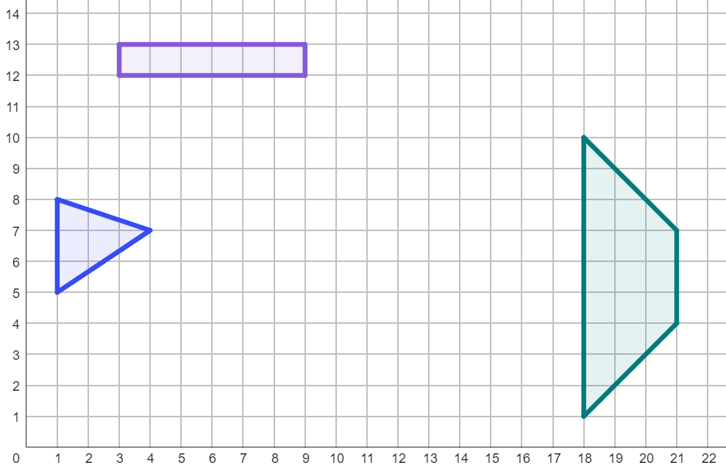
Rotating objects with centre outside the object
3) Follow the instructions to rotate each object so the images combine to create a picture.
90° clockwise
centre around (15, 8)
90° anti-clockwise
centre around (12, 14)
180°
centre around (7, 8)

Slide 32
Rotating objects with centre outside the object
1) Rotate object A by 90° clockwise around the point (7, 5).
2) Rotate object A by 90° clockwise around the point (6, 0).
1)
2)

Slide 33
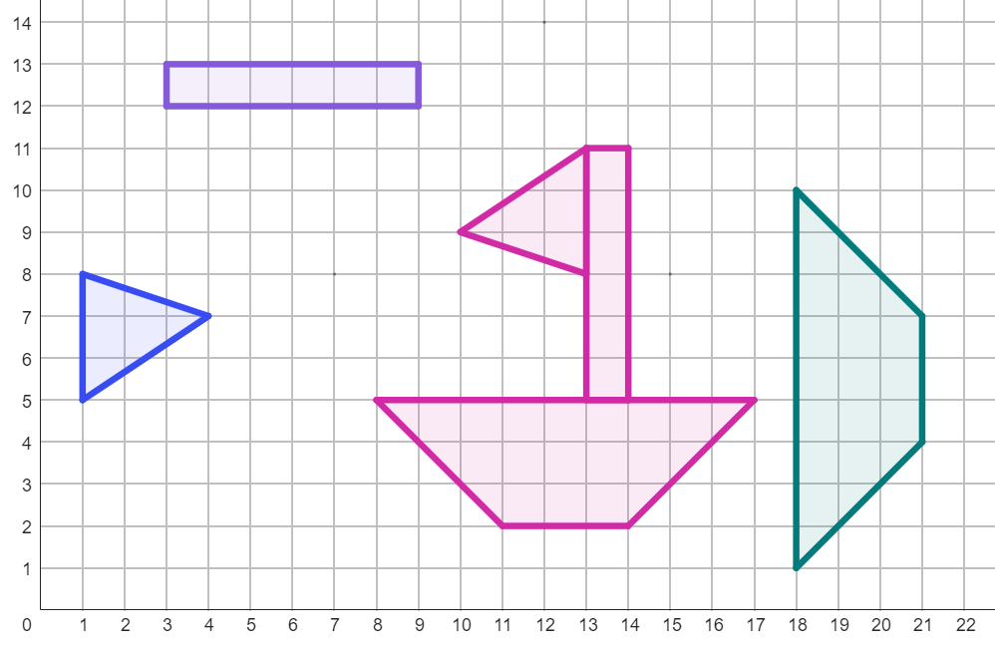
Rotating objects with centre outside the object
3) Follow the instructions and rotate each object so the images combine to create a picture.
90° clockwise
centre around (15, 8)
90° anti-clockwise
centre around (12, 14)
180°
centre around (7, 8)

Slide 34
Rotating objects
Rotating with tracing paper and centre on a vertex
Rotating objects with centre outside the object
Rotating objects with centre in or on the object

Slide 35
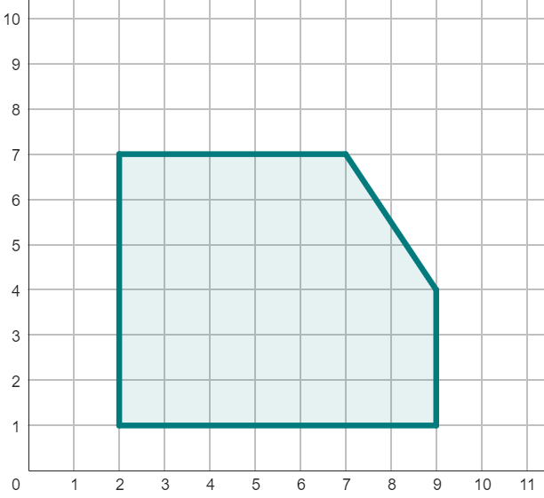
Rotating objects with centre in or on the object
The centre of rotation may be on the perimeter of the object, or inside it.
on the perimeter
The method for rotating these objects does not change. You must be careful, as the image is more likely to overlap the object and so it can be more confusing.
Many of the vertices of the image will overlap the object, so you must mark the centre of rotation and the vertices on the tracing paper very carefully.
inside the object

Slide 36
Rotating objects with centre in or on the object
For example: rotate this object by 180° around the centre of rotation of (6, 5).
Instructions
Plot the coordinate of the centre of rotation first - make sure this is clear!
Trace the shape and centre of rotation on the tracing paper and rotate.
Make sure to press your pencil into the paper hard enough so you can see the vertices that overlap the object.

Slide 37
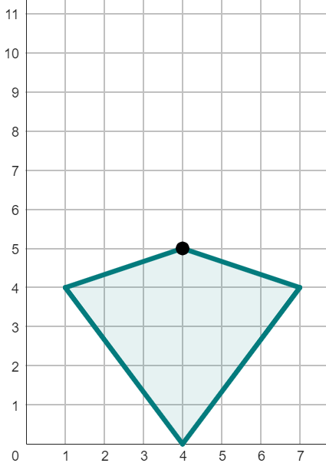
Rotating objects with centre in or on the object
The object is rotated 180° around the point (4, 3).
What is the first step to drawing this rotation?
a
Rotating the tracing paper.
T
b
Sketching the shape onto tracing paper.
c
Marking the centre of rotation.

Slide 38
Rotating objects with centre in or on the object
The object is rotated 180° around the point (4, 3).
At which point does vertex T end up after the rotation?
a
(4, 0)
T
The vertices of an object can end up inside the shape after rotation.
b
(4, 7)
c
(4, 1)

Slide 39
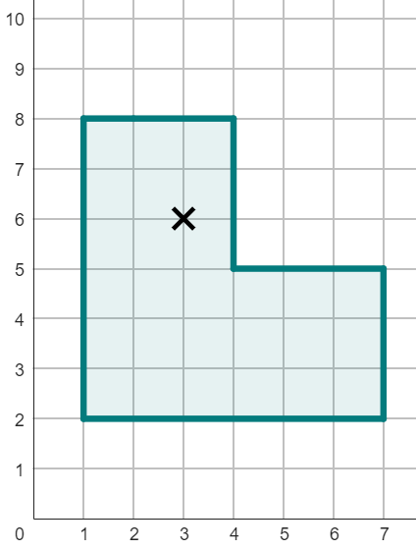
Rotating objects with centre in or on the object
1) Rotate this shape by 90° anti-clockwise around the point (3, 6).
2) How many unit squares of overlap are there between the object and its image?

Slide 40
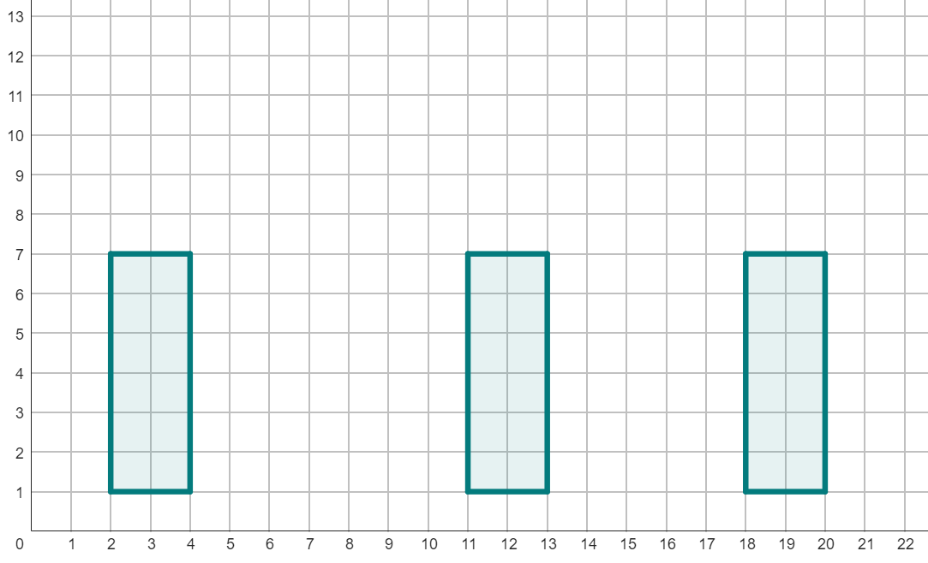
Rotating objects with centre in or on the object
3) Rotate each of these rectangles by the descriptions given.
180°
centre around (12, 7)
270° anti-clockwise
centre around (3, 2)
450° anti-clockwise
centre around (19, 4)

Slide 41
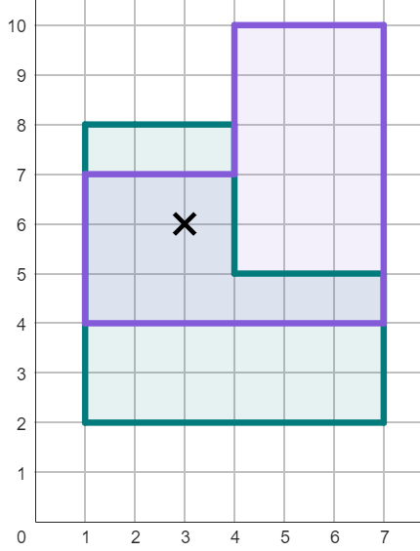
Rotating objects with centre in or on the object
1) Rotate this shape by 90° anti-clockwise around the point (3, 6).
2) How many unit squares of overlap are there between the object and its image?
12 unit squares

Slide 42
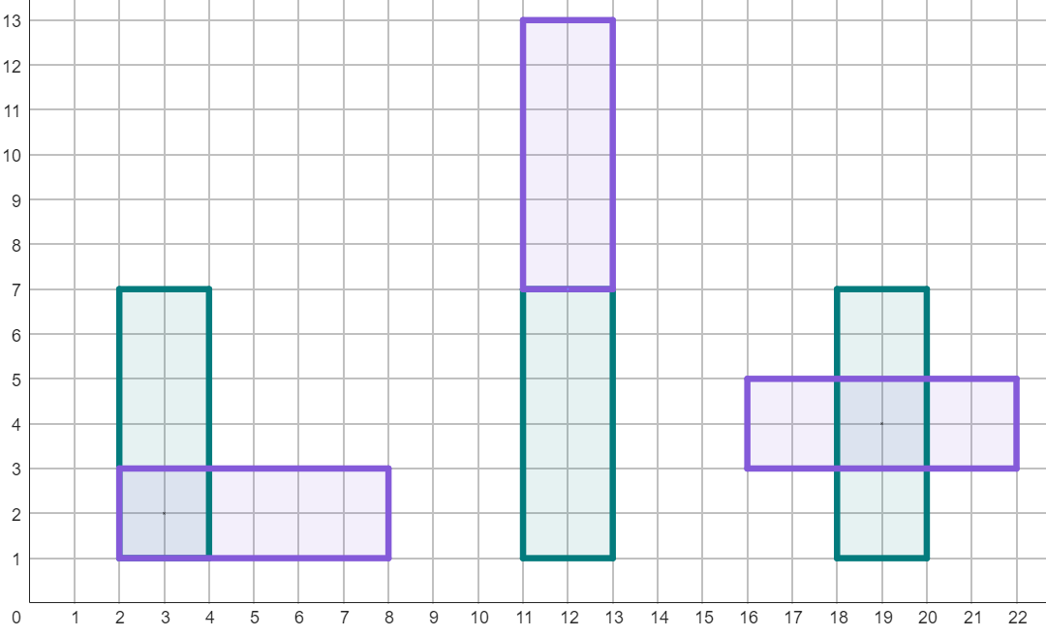
Rotating objects with centre in or on the object
3) Rotate each of these rectangles by the descriptions given.
180°
centre around (12, 7)
270° anti-clockwise
centre around (3, 2)
450° anti-clockwise
centre around (19, 4)

Slide 43
Rotating objects
Tracing paper can be used to help rotate objects.
The image of a rotation will only have the same orientation if the object is rotated a full turn (360°), or multiples of a full turn.
Rotations can occur with the centre of rotation either:
on a vertex of an object
outside the object
inside or on the object

Slide 44

© Oak National Academy 2023.
Produced in partnership with Mathematics in Education and Industry
Licensed on the Open Government Licence v3.0, except where otherwise stated. See Oak terms and conditions.

